Slide 1
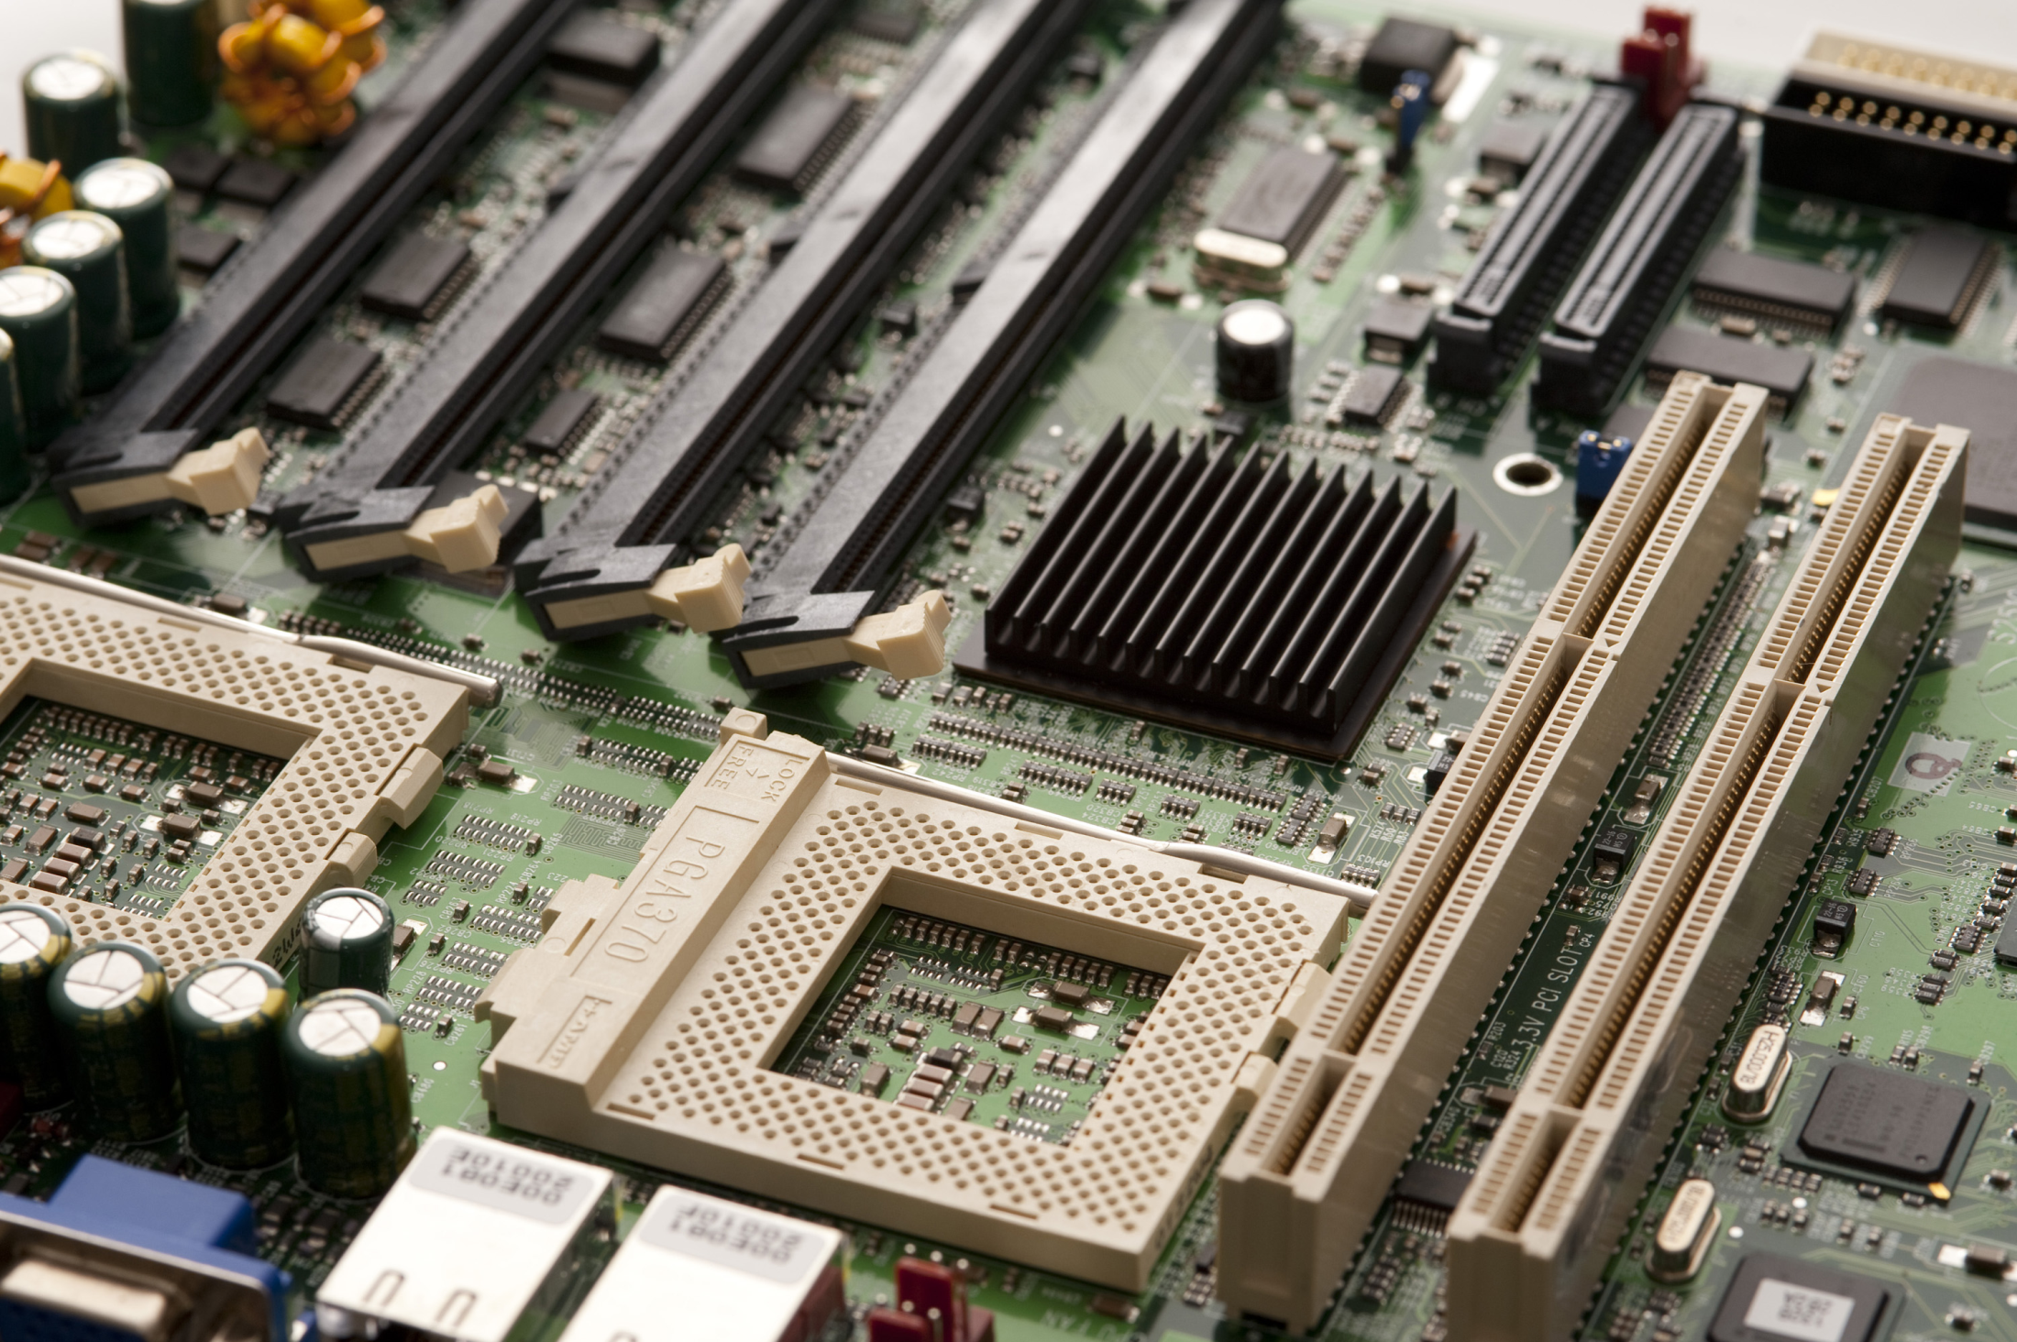
SC1006
Computer Organization and Architecture
Polling, Interrupt and DMA - Questions

Slide 2
Which of the following statement is FALSE?
Where responding to the intended trigger event is concerned, polling- based mechanism would be able to respond faster than an interrupt-based mechanism.
In Polling based mechanism, CPU has complete control over the entire trigger event detection process.
Interrupt based systems can execute tasks more efficiently.
Its easier to debug interrupt-based application since the initial process is handled by the hardware.
[A] Polling is able to yield faster response if the software is dedicated to the target status. Just that it’ll take up 100% of the CPU.
[B] Polling is software based. User have full control.
[C] In interrupt-based systems, CPU is able to proceed with its task and doesn’t need to monitor the status constantly.
[D] When a process is handled in hardware, the status of the operation is not as readily available, typically only via some status registers. So, when an issue occurs, there is less information available to the user and therefore more difficult to debug.

Slide 3
Which is the correct sequence of event for an interrupt control flow? a: CPU suspend current program b: Device send interrupt request c: CPU return to interrupted program d: CPU branch to Interrupt Service Routine e: CPU decides to service the interrupt request
b, a, c, d, e
b, a, e, d, c
b, e, a, d, c
b, e, d, a, c

Slide 4
Why is interrupt based code more difficult to debug?
Interrupt mechanism involves more hardware.
More difficult to observe the state of hardware when issue occurs
Interrupts are asynchronous in nature, i.e. can occur anytime
All of the above

Slide 5
Which of the following information about DMA is FALSE?
DMAC is a separate module in a computer system used to relieve CPU from the task of transferring data.
Transferring data via DMA is always faster than using CPU.
CPU response time to other tasks will be the slowest when Burst mode DMA is used because the DMAC will transfer the entire block of data before releasing the system bus.
Transparent mode DMA results in the slowest transfer rate as it will only operate when the CPU is not using the system bus.
Transferring via CPU can be faster than DMA as CPU speed is typically faster, just that do so means wasting CPU resources to just transfer data.

Slide 6
**What is/are the advantages of using a DMAC instead of a CPU to transfer data?
DMAC is a separate bus controller
CPU does not need to perform the data transfer task and can focus on doing data processing.
DMAC is more efficient in performing data transfer for data with specific formatting, e.g. audio and video data.
DMAC is always able to transfer data at a faster rate compared to CPU.

Slide 7
What are the basic parameters that DMAC needs to perform a data transfer?
source address, destination address, read/write operation, end symbol
source address, number of bytes, destination address, end symbol
Source address, destination address, trigger signal, number of bytes
Source address, trigger signal, number of bytes, end symbol

Slide 8
If your application requires good system response with fairly good data transfer capability, which DMA mode would you use?
Transparent
Cycle Stealing
Burst

Slide 9
Which DMA transfer mode is capable of sustaining the fastest transfer rate?
Transparent
Cycle Stealing
Burst

Slide 10
**Which of the following determine the DMA data transfer rate of a system?
Transfer rate of the slowest module
Type of DMA transfer mode used
CPU’s System Bus utilization rate
Transfer rate of the faster module
This question assume that DMAC and CPU share one system bus. When CPU uses the system bus frequently, DMAC will have less chance to use the bus and will have to transfer data at a slower rate.
In general, transfer rate among a group of modules will be limited by the slowest module in the group. Very much like the speed of a convey will be limited by the slowest vehicle in the convoy.

